Slide 1
Due to extremely high demand, please make a copy of this training (Click File > Make a Copy) and work through your copy. This helps keep the site from crashing. Thank you!
-The Seesaw Team

Slide 2

Remote Learning for Teachers New to Seesaw

Slide 3

Seesaw brings together students, teachers, and families to deepen student learning.
Remote learning is a core part of Seesaw’s Learning Loop.

Slide 4
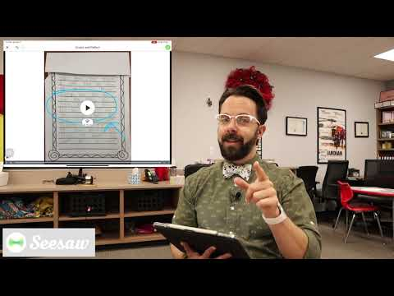
Notes:
Video link: https://youtu.be/RdFms78FtxU

Slide 5
Learning at Home is Different...
A child’s home and community is a unique, powerful learning environment.
Teachers and family members need to work together to support continuous learning experiences.
Content that integrates the home environment and relationships makes remote learning more effective.
It is not realistic to replicate the school day at home. Focus on high priorities and encourage families to look for daily learning moments they can enjoy together..
Supporting students to work independently is important. Because students are working at home, we need to provide content that respects the family role and gives families the tools they need to support their child.
Based on research by Epstein, Mapp, Moll, Yosso, and The Developmental Assets® Framework

Slide 6
Setting up Remote Learning
is as easy as 1, 2, 3
Set up your free teacher account*
Add students to your class(es)*
Access Home Learning Codes
*Not applicable to Seesaw for Schools teachers

Slide 7
STEP 1:
Create your free teacher account
Seesaw for Schools teachers skip to Step 3
Notes:
NOT APPLICABLE TO SEESAW FOR SCHOOLS TEACHERS: Your admin will create your account.

Slide 8
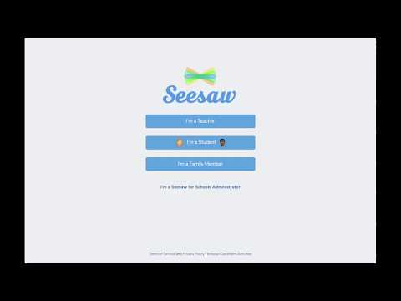
STEP 1: Click I’m a Teacher
STEP 2: Choose Create Account
STEP 3: Enter your information, or sign up with a Google account
STEP 4: Create a class. Name your class and choose a grade level, or Import a roster from Google Classroom.
STEP 5: Click the green check.
Notes:
Video link: https://youtu.be/7tT0HCmvyQs
NOT APPLICABLE TO SEESAW FOR SCHOOLS TEACHERS: Your admin will add students to your classes.

Slide 9
It’s your turn
Open a new tab and create or log in to a Seesaw account.
Notes:
NOT APPLICABLE TO SEESAW FOR SCHOOLS TEACHERS: Your admin will create your account.

Slide 10
STEP 2:
Add students to your class
Seesaw for Schools teachers skip to Step 3
Notes:
NOT APPLICABLE TO SEESAW FOR SCHOOLS TEACHERS: Your admin will add students to your classes.

Slide 11
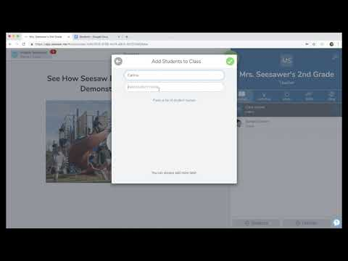
STEP 1: In the bottom right, click +Students
STEP 2: For remote learning, choose ‘No’ when asked if students use email addresses to sign in.
STEP 3: Choose Shared or 1:1 Devices
STEP 4: Enter each student’s name, or paste a list of names.
STEP 5: Tap the green check.
Notes:
Video link: https://youtu.be/JVngd3KSFRY
Typically, we would advise that you invite family members to view student work. However, since work is being completed remotely at home, we are not advising you to invite family members at this time.
NOT APPLICABLE TO SEESAW FOR SCHOOLS TEACHERS: Your admin will add students to your classes.

Slide 12
It’s your turn
Go to your Seesaw tab. Add students to your class(es) by:
Clicking +Students in the bottom right
Typing or pasting a list of student names
Clicking the green check
Notes:
NOT APPLICABLE TO SEESAW FOR SCHOOLS TEACHERS: Your admin will add students to your classes.

Slide 13
STEP 3:
Get Home Learning Codes
Notes:
SEESAW FOR SCHOOLS TEACHERS: Your administrator MAY get your students’ codes for you. If your administrator wants you to get students codes, they will need to enable this setting in their admin dashboard.

Slide 14
What are Home Learning Codes?
Home learning codes allow students to securely sign in to the Seesaw Class app from home. They can access all learning tools but can not login as another student or see the work of other students in the class.
Each student has a unique QR code and 12-letter text code.
Codes are available in a PDF (one page per student) or CSV (by class or for all students the teacher teaches)
If you click ‘Get Home Learning Codes’ again, you will generate new codes for all students. Don’t worry! All old codes (up to 50 per student) will remain valid for up to 90 days.
Once signed in, students will stay signed in for up to 1 year or until they sign out.
Treat codes like a password. If a student code is being used inappropriately by anyone other than the student. It needs to be invalidated, email help@seesaw.me.

Slide 15
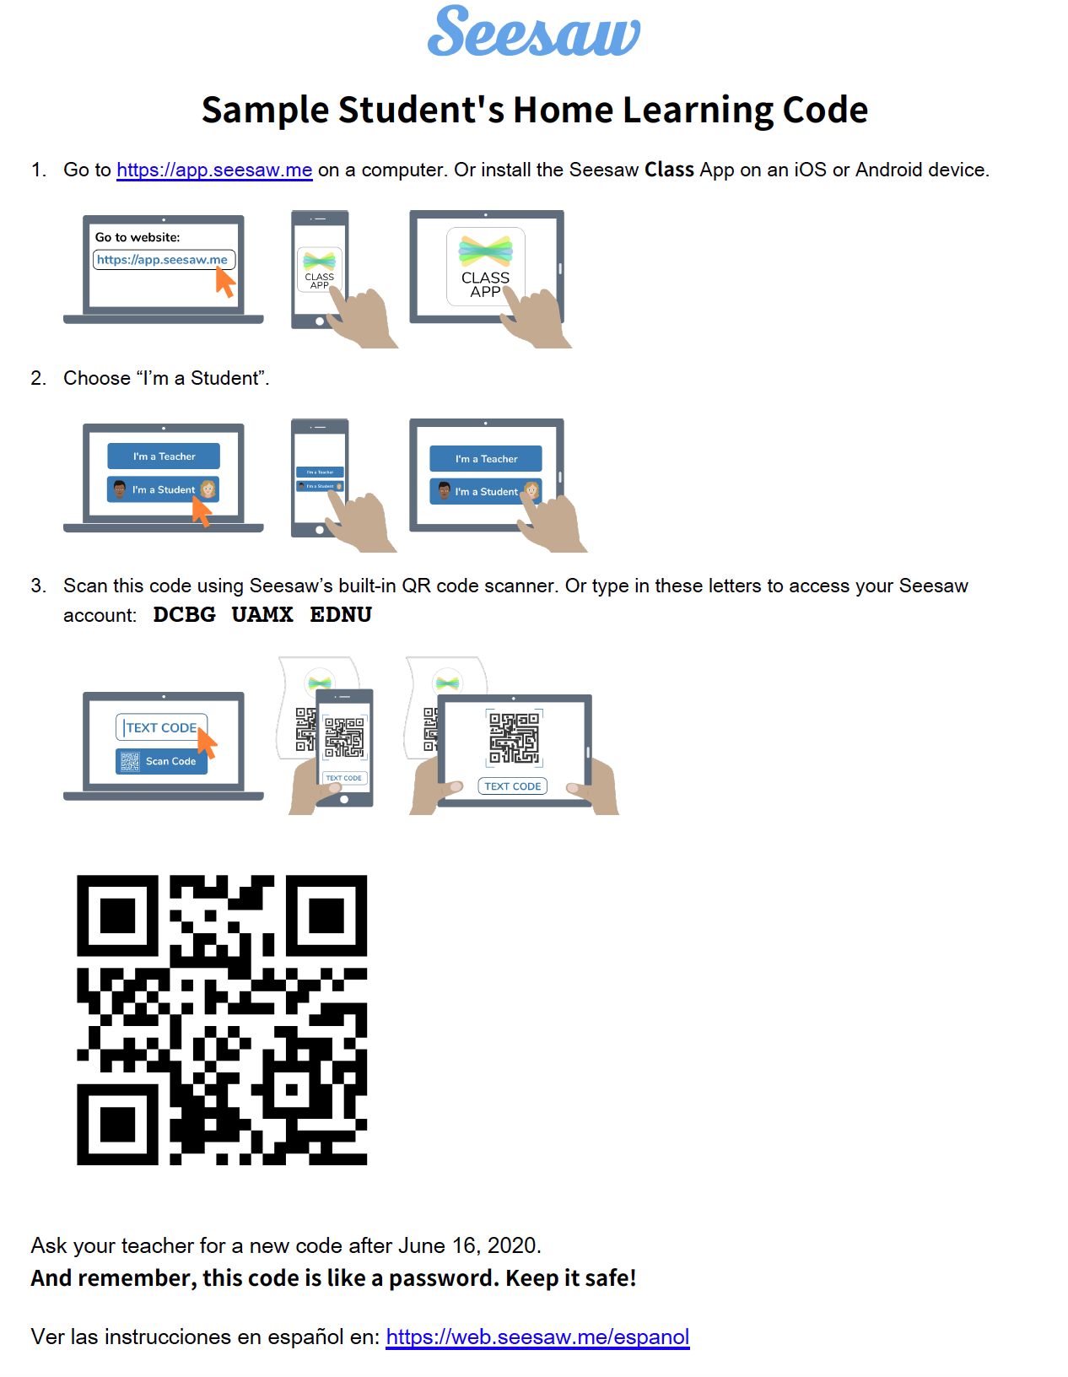
Example of a Home Learning Code PDF

Slide 16
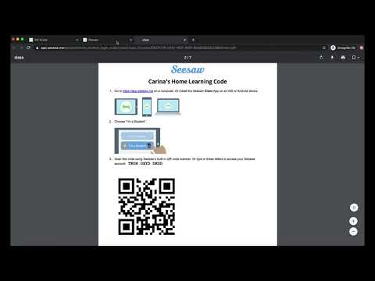
STEP 1: On a computer, go to app.seesaw.me and log in.
(You cannot get codes from the mobile app.)
STEP 2: On the banner at the top of your page or in Class Settings, click ‘Get Home Learning Codes’.
STEP 3: Download a PDF for each student (includes text and QR codes) or download a CSV of text codes.
Notes:
Video link: https://youtu.be/QKfxHdgI7nQ

Slide 17
It’s your turn
Go to your Seesaw tab. Get students’ Home Learning Codes by
Clicking Get Home Learning Codes on the banner at the top of your screen
Choosing PDF or text codes
Here’s a one-pager that walks you through the steps for future reference.
Notes:
One pager link: https://docs.google.com/document/d/1NbVTv-_tow_rM9zNrLlBrF4ziFna039ba-ic5vIDNPM/edit

Slide 18
Congrats! You’re set up.
Now, let’s see how students log in with
Home Learning codes.

Slide 19
Get Ready to Watch
Students log in with Home Learning Codes

Slide 20
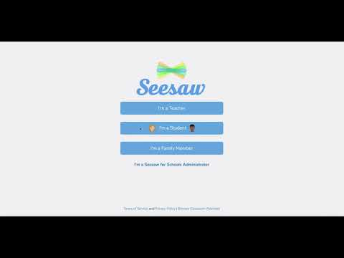
STEP 1: On a computer visit app.seesaw.me OR download the Seesaw Class app.
STEP 2: Choose I’m a Student.
STEP 3: Enter their unique text code or scan their unique QR code.
Notes:
Video link: https://youtu.be/dFDT1ZRIMnU

Slide 21
one-pager in English, and one-pager in Spanish
To sign in, students will...
Go to app.seesaw.me OR install or update the Seesaw CLASS app
*Home Learning Codes only work with an updated version of the Class app. They do not work on the Family app.
Choose I’m a Student
Enter their unique home learning text code OR scan their unique home learning QR code
Here’s a one-pager that shows students how to do it: English | Spanish
Notes:
One pager link: https://docs.google.com/document/d/1oUDd0KM5rYWv1NTR7kML65qyBW9uYLU-H1FVEmN3dFk/edit?usp=sharing
Spanish link: https://docs.google.com/document/d/1E69m5pUzrhEthpfLoYfaO7UmHphCGTq6skScNOenXQ4/edit?usp=sharing

Slide 22
Families Play an Important Role
Encourage families to...
Create a home learning routine and distraction-free space.
Support learning at home by collaborating with (vs. instructing) students to complete assignments
Provide positive, encouraging feedback that reinforces a growth mindset
Feel ok about not having all of the answers
Here are home learning ideas to share with families: English | Spanish
Notes:
Home learning ideas in English:
https://docs.google.com/document/d/1HGDDYZ1LD0LeNkzvEeMeIduDUQ72khmmsBwgsw2KZo0/edit?usp=sharing
Home learning ideas in Spanish: https://docs.google.com/document/d/1g432FWQHvyO4u5EDLkiKOERou9n3EyOomcU98Ma4Vc0/edit?usp=sharing

Slide 23
Let’s take a look at how Seesaw works

Slide 24
The following slides show...
Viewing student work on the Teacher Dashboard
Approving student posts
Students posting to the journal
Teachers posting to the journal, including to ‘All Students’
Creating activities

Slide 25
Get Ready to Watch
2 ways to see student work on the teacher dashboard

Slide 26
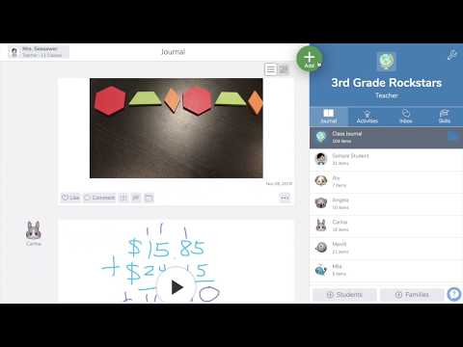
VIEW 1: On the Journal tab, you’ll see all student’s work in the feed on the left of your screen..
VIEW 2: You can click on any student’s name on the right of your screen to see only that student’s work.
Notes:
Video link: https://youtu.be/gAzsX4RvwXc

Slide 27
Get Ready to Watch
Approving student work

Slide 28
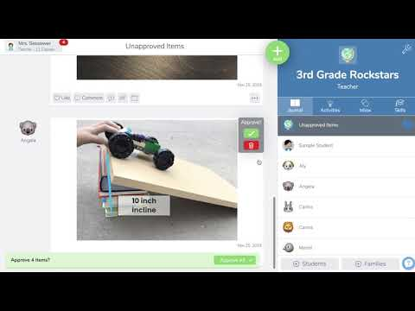
When students add work to Seesaw, it always comes to the teacher first for approval.
STEP 1: On the red bar at the bottom of your screen, tap Review.
STEP 2: You can approve each post one at a time, or click Approve All to approve all.
Notes:
Video link: https://youtu.be/3MIGCGEis9A

Slide 29
Get Ready to Watch
How students post to their journal

Slide 30
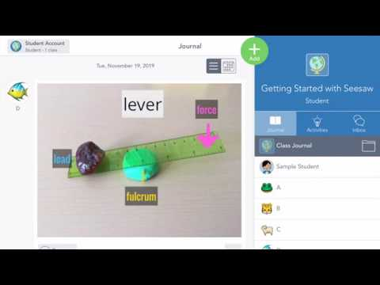
STEP 1: Students tap the green Add+ button.
STEP 2: Choose a learning tool from the menu.
STEP 3: When done, click the green check to add the post.
Note: With Home Learning Codes, students do not need to choose their names from the list, as the video shows.
Notes:
Video link: https://youtu.be/CBJPfpNtiMY

Slide 31
Get Ready to Watch
How teachers post to the
class journal

Slide 32
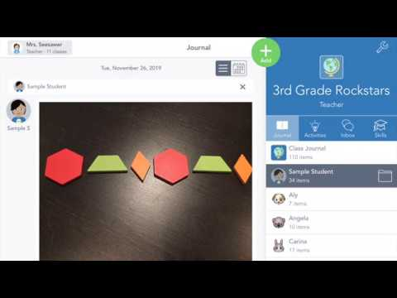
STEP 1: Click the green Add+ button and choose Post Student Work.
STEP 2: Use learning tools to create a post.
STEP 3: Click the green check to add teh post.
PRO TIP: Choose ‘All Students’ to share posts with every student’s journal. This is a great way to communicate to all students and families while doing remote learning.
Notes:
Video link: https://youtu.be/T88pAOfWu58

Slide 33
You just learned how students and teachers post to Seesaw using the green Add+ button.
Adding to the journal (posting) in this way is best when students already know what to do (e.g. when you’ve given them directions outside of Seesaw)

Slide 34
Students can also post by responding to an activity you’ve assigned in Seesaw
With Seesaw activities, you can provide directions, multimedia resources, and templates inside of Seesaw that students respond to directly.
Learn how on the following slide.

Slide 35
Get Ready to Watch
Create activities in Seesaw

Slide 36
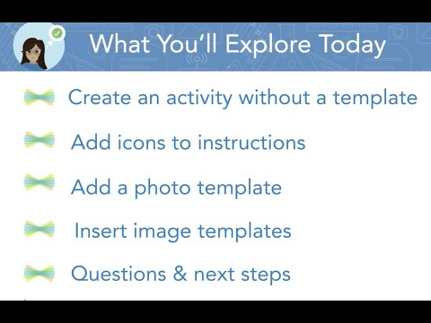
STEP 1: Click the green Add+ button and choose Assign Activity.
STEP 2: You’ll be in My Library. Choose Create New Activity.
STEP 3: Enter the title and directions, add multimedia instructions or an example, add a template. And more!
STEP 4: Click Save.
STEP 5: You’ll be back in My Library. Click Assign, choose the class or specific students. Click Assign.
Your activity will show up in the Activities tab.
Notes:
What are templates?
Students will complete the activity using the template. They will be able to use all learning tools on top of anything you upload here.
Video link: https://youtu.be/JN0ry2kFlM0

Slide 37
The Seesaw icons shortcuts
can be found HERE.
Notes:
Icon shortcuts link: https://help.seesaw.me/hc/en-us/articles/115005120583-Seesaw-Icon-Shortcut

Slide 38
We created a map of ready-to-go Seesaw activities for home learning organized by grade and subject.
You can find it HERE.
Notes:
Link to activities: here

Slide 39
Troubleshooting & FAQs
Due to unusually high demands on our Help Center at this time, we kindly ask that you try to find the answer to your questions before submitting a help ticket. Here are three resources to help:
Main site for teachers: web.seesaw.me/remote-learning
FAQs: http://bit.ly/RemoteFAQs
Live Help Webinar: http://bit.ly/LIVEhelp

Slide 40
We’d love your feedback!
We are learning right alongside you!
Please take 60 seconds to answer 2 questions here.
Notes:
Survey link: https://docs.google.com/forms/d/e/1FAIpQLSeu4JjuGO74QVCNXyoPflKWLI3FLPMcBu7HLnNgIg65PNSl2w/viewform?usp=sf_link

